Slide 1
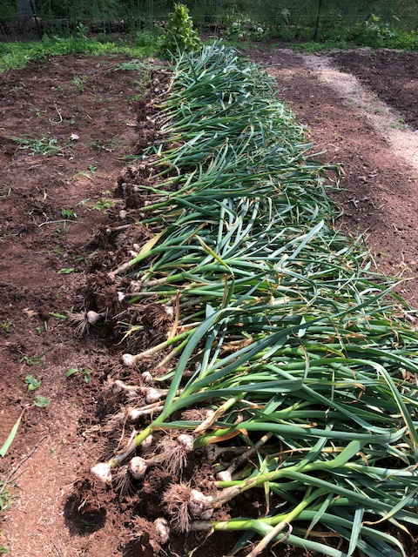
Montgomery County Farm to Food Bank
How to sell or donate your farm products through Manna Food Center’s Community Food Rescue Program

Slide 2
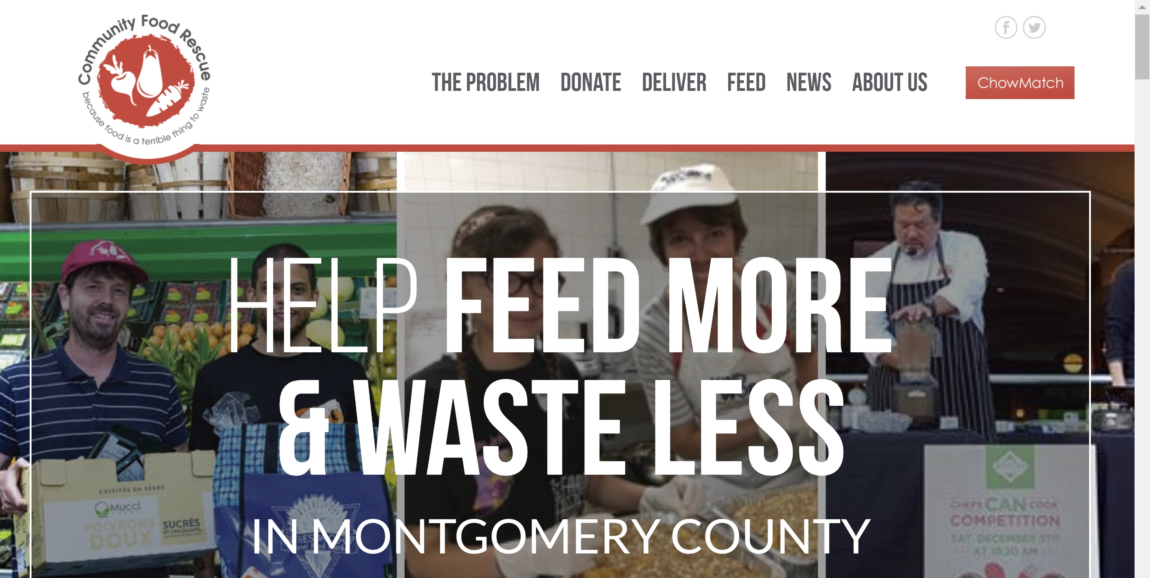

Slide 3
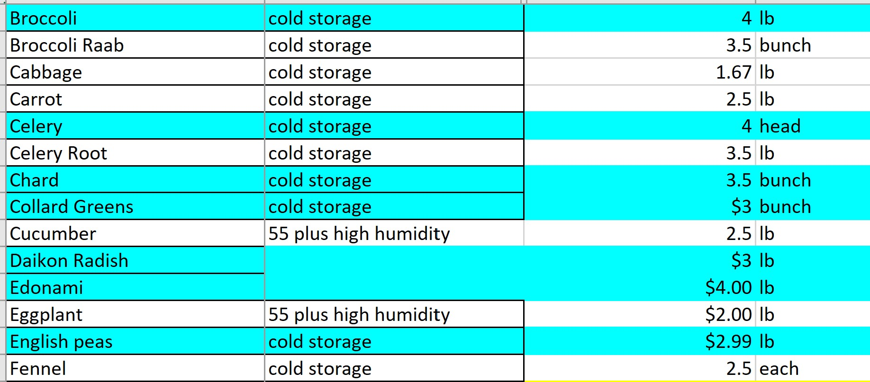

Slide 4
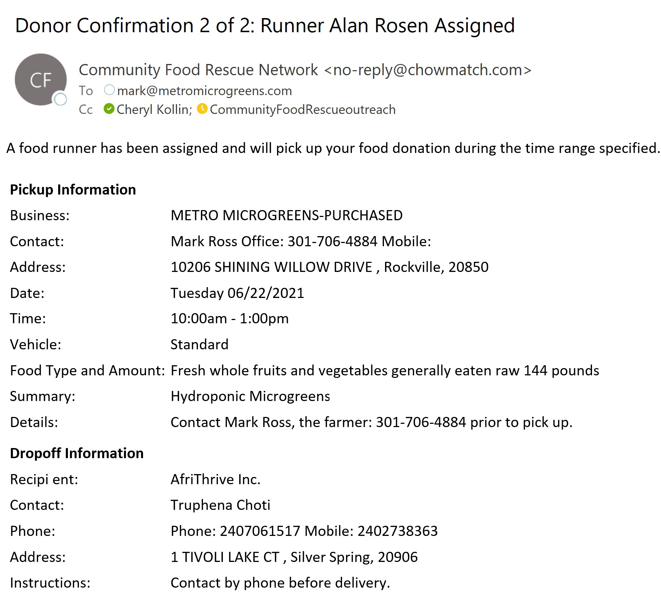

Slide 5
Important Invoice Elements:
Farm Name and Farm Address
Unique Invoice #
Date invoice was drafted
Date of any transaction(s)
What was sold and how much
Cost per unit
Total cost for each transaction
Total amount due

Slide 6
Montgomery County Farm to Food Bank
To Sell: Make an Offer using Farm to Food Bank and your farm’s PURCHASE ACCOUNT
Contact Susan Wexler, communityfoodrescueoutreach@mannafood.org
To Donate: Schedule a Food Run using your farm’s DONATION ACCOUNT
Contact Cheryl Kollin, Cheryl@communityfoodrescue.org
To discuss pricing, contact Jenna Umbriac
jenna@mannafood.org 240-268-2535

Slide 7
Montgomery County Farm to Food Bank
THANK YOU!

